Slide 1
SMART CAREER GUIDANCE AND COURSE RECOMMENDATION SYSTEM

Slide 2
ABSTRACT
Smart Career Guidance and Course Recommendation System is an integrated web-based application developed to help students choose suitable career paths after completing their school education. The system is developed using HTML, CSS, and JavaScript for client-side development, Python with the Flask framework for server-side processing, and SQLite for database management. The system provides a centralized platform where students can assess their interests and receive guidance on appropriate courses and career options. The application overcomes the limitations of traditional career guidance methods by providing automated recommendations, structured information about courses, and easy access to educational resources.
The system is divided into several important modules such as User Registration and Login, Career Assessment, Course Recommendation, Skills Guidance, and College Information. The Career Assessment module allows students to answer a set of aptitude-based questions designed to understand their interests and strengths. Based on the student’s responses, the system analyzes the results and recommends suitable courses along with details such as duration and eligibility. The Skills module provides information about skills required for the recommended courses along with links to online learning platforms. Additionally, the system provides information about colleges offering the recommended courses and allows students to download city-wise college lists. This system helps students make informed career decisions and simplifies the process of selecting higher education paths.

Slide 3
INTRODUCTION
Choosing the right career path is one of the most important decisions in a student’s life. Many students face confusion after completing their school education due to a lack of proper guidance and limited information about available courses and career opportunities. Traditional career guidance methods often rely on manual counseling, which may not always provide personalized recommendations for every student.
The Smart Career Guidance and Course Recommendation System is developed to address these challenges by providing a digital platform that helps students identify suitable career paths based on their interests and abilities. The system uses a web-based architecture where users can access the platform through a web browser, and the server processes requests using Python with the Flask framework while storing data in a database.
The system offers:
Career aptitude assessment for students
Automated course recommendations based on assessment results
Information about course duration and eligibility
Skill suggestions and learning platform links
Access to city-wise college information

Slide 4
SOFTWARE DESIGN
Software design defines how the components of a system are structured and how they interact to achieve the project objectives. The process flow of the Career Recommendation System provides an overview of how the application works, from user input to generating personalized career recommendations.
The system follows a client-server architecture, where the frontend acts as the client and the backend acts as the server. The frontend provides an interactive web interface for users to enter their details and answer the aptitude questionnaire. The backend processes user inputs, performs machine learning computations using the KNN algorithm, interacts with the database, and generates recommendations.
The overall process flow is as follows:
User registers and logs into the system
User completes the aptitude questionnaire
Responses are sent to the backend
KNN algorithm processes the input and finds similar patterns
System predicts suitable career paths and courses.
Upon generating recommendations, the following steps are performed:
Recommended courses are fetched from the database
Course details (duration, eligibility) are displayed
City-based college data is retrieved
Final recommendations are shown on the dashboard

Slide 5
CODING AND IMPLEMENTATION
Writing and Assembling the Software Code Based on the Design
The coding and implementation phase is the stage where the system design is transformed into a fully functional software application. The Career Recommendation System is implemented as a web-based application with a modular architecture.
The backend is developed using Python with the Flask framework, which handles routing, business logic, database operations, and machine learning integration using the KNN algorithm. The frontend is developed using HTML, CSS, and JavaScript, which provides an interactive user interface for users.
The frontend and backend are separated to improve code readability, maintainability, and scalability. Configuration files are used to store important details such as database configuration and secret keys.
The database is implemented using SQLite, and database models are created using SQLAlchemy. Tables such as Users, Courses, Colleges, User Responses, and Recommendations are defined as model classes.Each module of the system was developed and tested individually. After successful unit testing, all modules were integrated, and system-level testing was performed to ensure smooth functionality and error-free execution.

Slide 6
Development of Features and Modules
The system is divided into multiple functional modules, each responsible for a specific task. User Module
This module handles user registration and login functionalities. Users can create accounts, log in securely, and access personalized recommendations.
Aptitude Questionnaire Module:
This module presents a set of structured questions to users to understand their interests, skills, and preferences. The responses collected from users serve as input for the recommendation system.
Recommendation Module (KNN):
This is the core module of the system. It uses the K-Nearest Neighbors (KNN) algorithm to analyze user responses and predict the most suitable course.
Course Management Module:
This module manages course-related data such as course name, duration, eligibility, and stream.
College Recommendation Module:
This module provides a list of colleges offering the recommended course. It filters colleges based on the user’s selected city and displays relevant results.
Database Management Module:
This module handles data storage and retrieval using SQLite and SQLAlchemy.Relationships between tables are maintained using foreign keys.
Reporting and Display Module
This module displays results in a structured and user-friendly format.
The displayed data includes:
Predicted course,Recommended courses,Course details, City-based college list

Slide 7
CONCLUSION
The Career Recommendation System has been successfully designed and developed as a web-based application to assist students in choosing suitable career paths based on their interests, skills, and preferences. The primary objective of the project was to build an intelligent system that can analyze user responses and provide accurate course recommendations using machine learning techniques.
The system effectively collects user input through an aptitude-based questionnaire and processes the data using the K-Nearest Neighbors (KNN) algorithm to predict the most appropriate course. It also provides additional recommendations along with course details such as duration and eligibility criteria, helping users make informed decisions.
The application is designed to manage and display relevant data efficiently, including course information and city-wise college listings. The integration of a college recommendation feature enhances the usability of the system by connecting career guidance with real-world educational opportunities.
During the development of this project, practical knowledge was gained in Python programming using the Flask framework, database management using SQLite and SQLAlchemy, and frontend development using HTML, CSS, and Jinja2. The implementation of machine learning using the KNN algorithm provided insights into how intelligent systems can be used for decision-making applications.
The system has been tested and validated to ensure accurate predictions, proper data handling, and smooth user interaction. Overall, the project provides a practical understanding of full-stack web development combined with machine learning and successfully fulfills the requirements of an application-based software project.

Slide 8

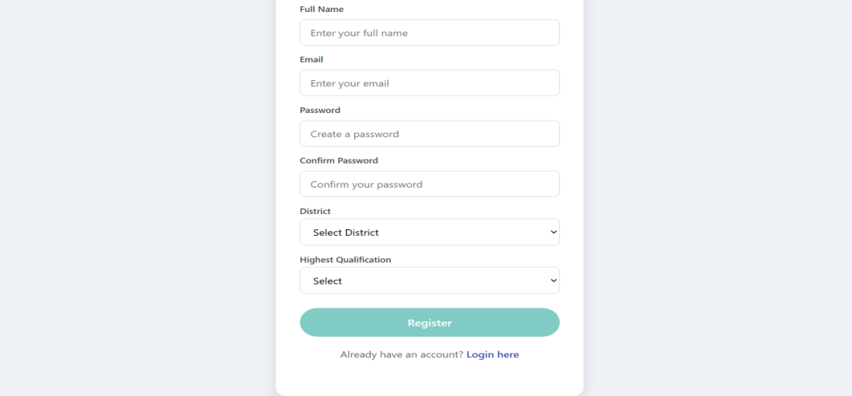
User Interface Screens
Home Page
The home page provides an introduction to the system and navigation options such as login, registration, and accessing different modules.
User Registration Page
This page allows new users to create an account by entering details such as name, email, and password.

Slide 9
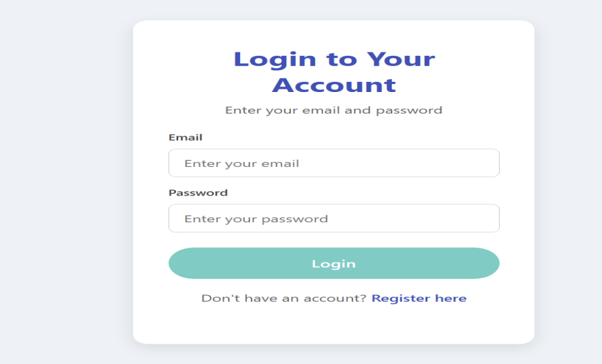
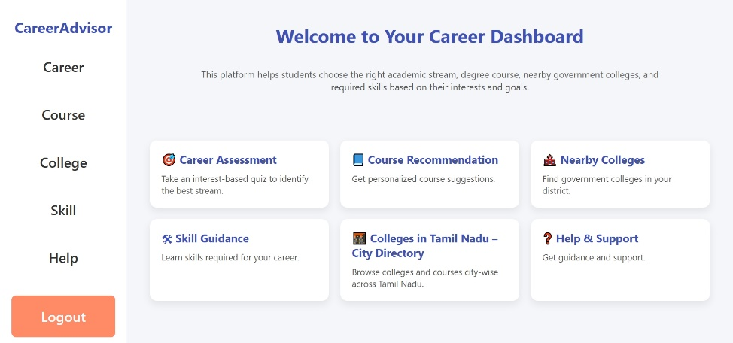
Login Page
Users can log in securely using their registered email ID and password.
Dashboard
The dashboard acts as the central interface where users can access:
Career assessment,Recommendations Colleges, Help page

Slide 10
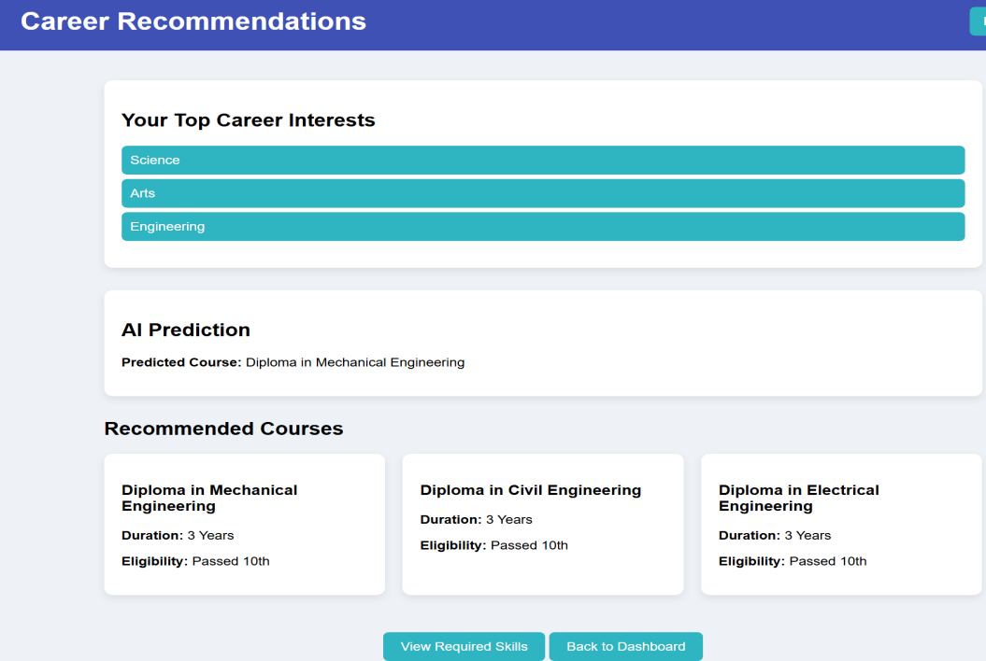
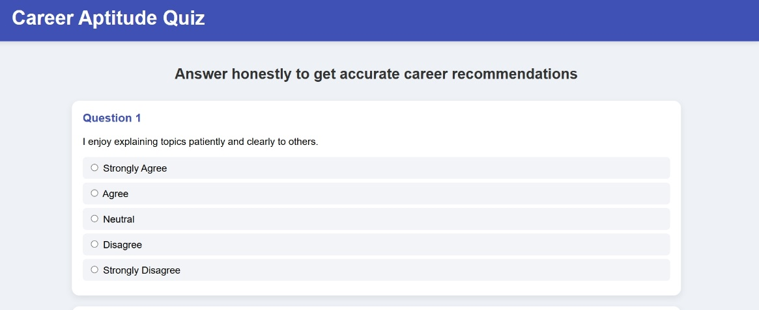
Career Assessment (Questionnaire Page)
This page contains aptitude-based questions that help in understanding the user’s interests and skills.
Recommendation Page
This page displays:
• Predicted Course (using KNN algorithm) • Recommended Courses

Slide 11
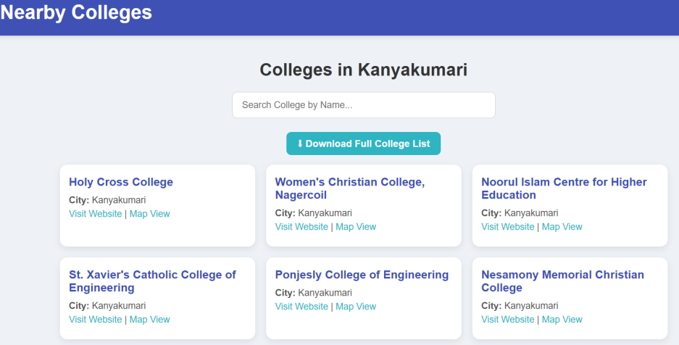
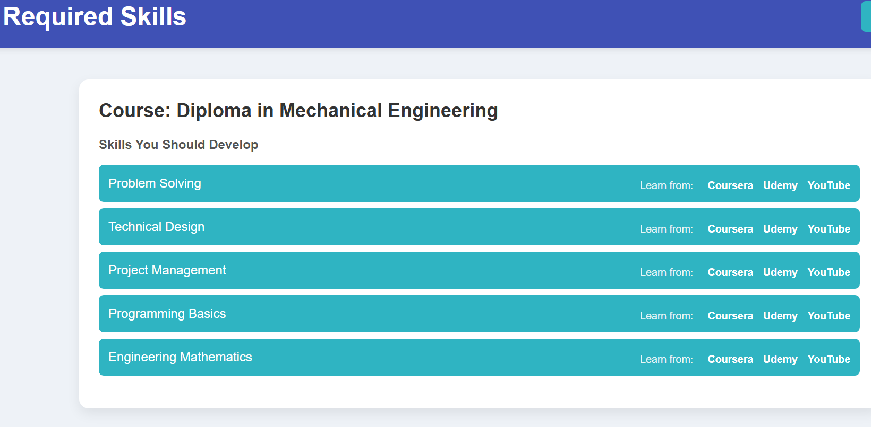
College Recommendation Page
This page shows:
• City-wise colleges • Course-based filtering
Skills Page
This page provides:
• Skills required for recommended courses • Learning resources

Slide 12
SOURCE CODE
from flask_sqlalchemy import SQLAlchemy
from flask_login import UserMixin
from werkzeug.security import generate_password_hash, check_password_hash
from sklearn.neighbors import KNeighborsClassifier
import numpy as np
db = SQLAlchemy()
# ---------------------- USER MODEL ----------------------
class User(UserMixin, db.Model):
id = db.Column(db.Integer, primary_key=True)
name = db.Column(db.String(100), nullable=False)
email = db.Column(db.String(120), unique=True, nullable=False)
password_hash = db.Column(db.String(200), nullable=False)
def set_password(self, password):
self.password_hash = generate_password_hash(password)
def check_password(self, password):
return check_password_hash(self.password_hash, password)

Slide 13
# ---------------------- COURSE MODEL ----------------------
class Course(db.Model):
id = db.Column(db.Integer, primary_key=True)
course_name = db.Column(db.String(150), nullable=False)
duration = db.Column(db.String(50))
eligibility = db.Column(db.String(100))
stream = db.Column(db.String(50))
# ---------------------- COLLEGE MODEL ----------------------
class College(db.Model):
id = db.Column(db.Integer, primary_key=True)
college_name = db.Column(db.String(150), nullable=False)
course_name = db.Column(db.String(150))
city = db.Column(db.String(100))
college_type = db.Column(db.String(50))
#--------------------- USER RESPONSE MODEL ----------------------
class UserResponse(db.Model):
id = db.Column(db.Integer, primary_key=True)
user_id = db.Column(db.Integer, db.ForeignKey('user.id'))
answers = db.Column(db.Text)
# ---------------------- RECOMMENDATION MODEL ----------------------
class Recommendation(db.Model):

Slide 14
id = db.Column(db.Integer, primary_key=True)
predicted_course = db.Column(db.String(150))
# ---------------------- KNN ALGORITHM ----------------------
def predict_course(user_input, X_train, y_train, k=3):
model = KNeighborsClassifier(n_neighbors=k)
model.fit(X_train, y_train)
user_input = np.array(user_input).reshape(1, -1)
prediction = model.predict(user_input)
return prediction[0]
# ---------------------- SAMPLE USAGE ----------------------
def get_recommendation(user_answers):
# Example training data (replace with real dataset)
X_train = [
[5,4,1,0], # Arts
[1,2,5,4], # Science
[3,5,2,4] # Commerce
]
y_train = [
"Diploma in Fashion Design",
"BSc Computer Science",
"BCom"
]
predicted = predict_course(user_answers, X_train, y_train
return predicted

